Slide 1












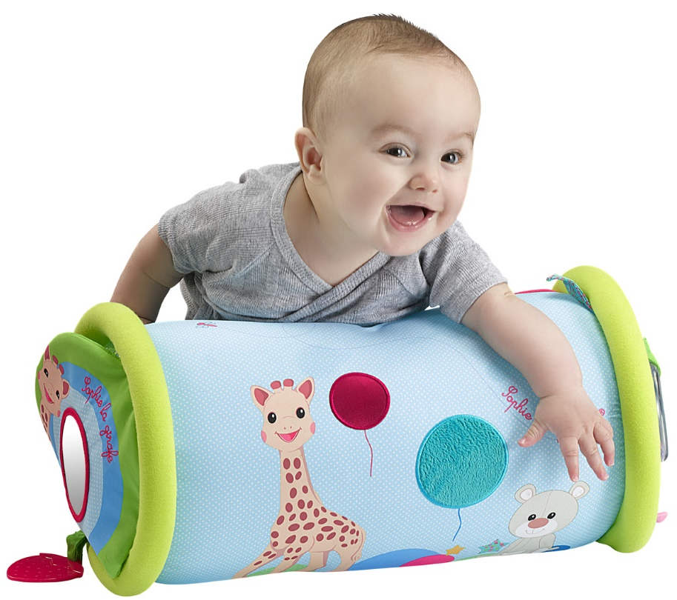

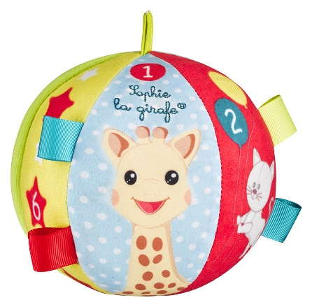












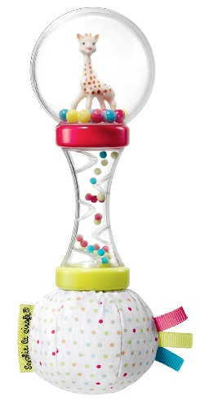


















Sensory awakening gift set
Gling !
Gling!

Slide 2
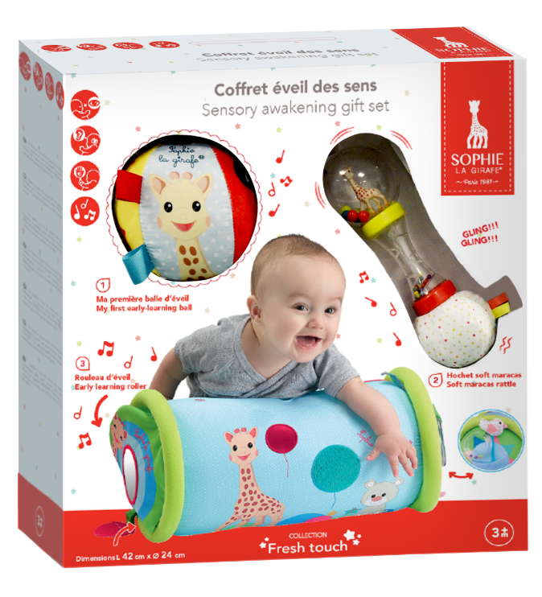
Sensory awakening gift set
An ideal box set to stimulate your baby’s 5 senses!
Contains:
A roller to climb, roll and straddle that develops your baby’s motor skills and balance. Whether lying down, sitting, or standing, your baby will safely have fun with the roller thanks to its quilted edges. Its fabric cover provides a feeling of comfort and softness. Several activities to explore designed to stimulate your baby’s 5 senses: mirrors, rattle, scented chewable parts, a variety of materials. Very lightweight and quick to inflate, it is easy to transport. The chewable part is detachable and washable. The cover is detachable and machine washable at 30°C.
A ball that is lots of fun 100% fabric to best stimulate your baby. Featuring bright colours and a little bell inside, the ball will stimulate your baby’s sight and hearing. Made from soft, textured materials, the toy’s round shape stimulates your baby’s sense of touch and develops their prehension abilities.
A soft maracas rattle – a must-have to entertain your baby! The handle’s ergonomic shape makes it easy to grab and manipulate. The multicoloured beads inside are funny to look at, and your baby will shake it to see and hear them bang together. Some features to explore: a rain stick and coloured beads that mix around Sophie la girafe. The all-fabric ball cleverly stimulates your baby’s senses through the sound of crinkled paper and the textured labels that make up its surface.
Réf.: 516361
EAN: 305656 516361 9
PCB: 6
Packaging: Windows box
Packaging dim: H 340 x L 320 x P 110 mm
Recommended age: 3 m+

